Slide 1

Handwriting Recognition
Group 1 - Arturo, Esther, Xianhao

Slide 2
Introduction
Brief outline of the project
Evaluation/test results
Reflections on results
The project management

Slide 3
Project Outline
Project Goal
The main project goal is to implement a system which can translate the carpenters drawings into a digital instruction set(machine readable language).
The handwriting recognition system
Exploring convolution neural networks (CNN) and computer vision algorithm to detect engineering symbols on Timber(a carpenter's work piece).
Identify the symbols and the information it contains.
Read cut-line dimensions
Identify the piece which needs to be cut
Tools and Resources
Convolution neural networks (CNN)
Open Source Computer Vision Library(openCV)
Tensor Flow
Keras
Colab platform

Slide 4
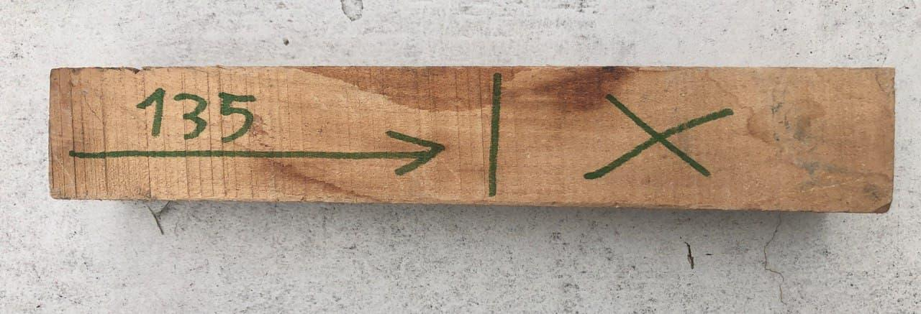
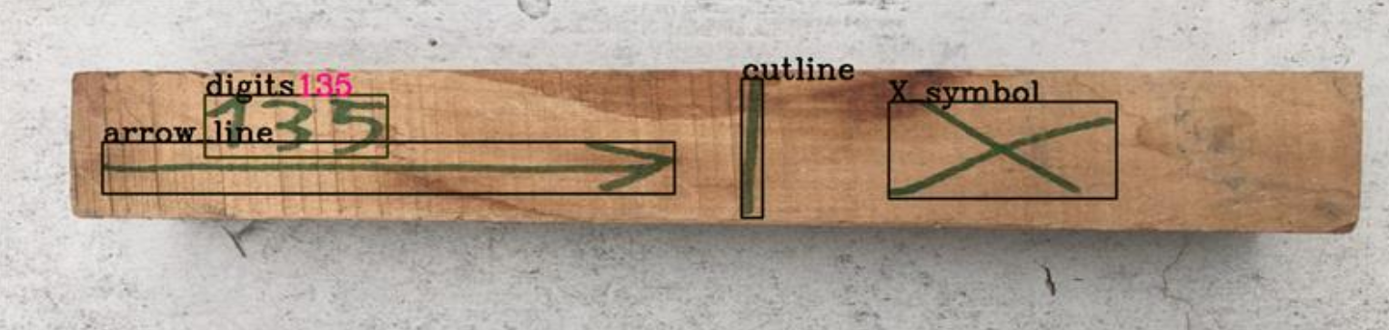
The System Pipeline
The handwriting recognition system
Pre-processing
Symbol Classification
(CNN Model)
Digit Recognition
(CNN Model)
Input image
output image
Original image
Output image
Recognised and classified all symbols
Identified cut line, dimension line and piece to be discarded.

Slide 5
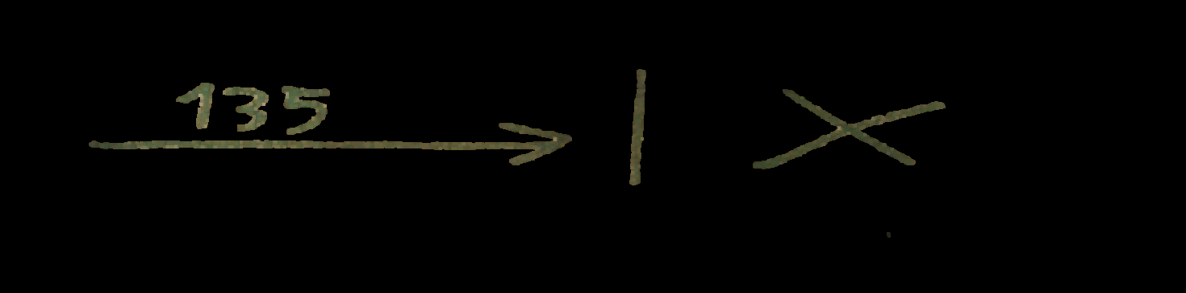
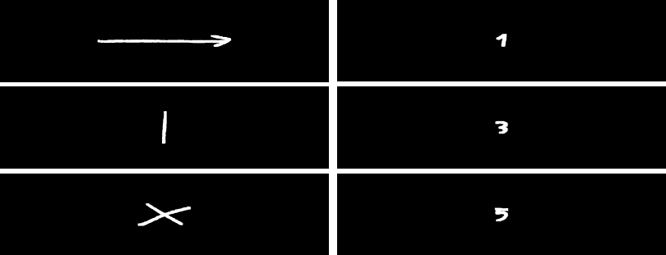
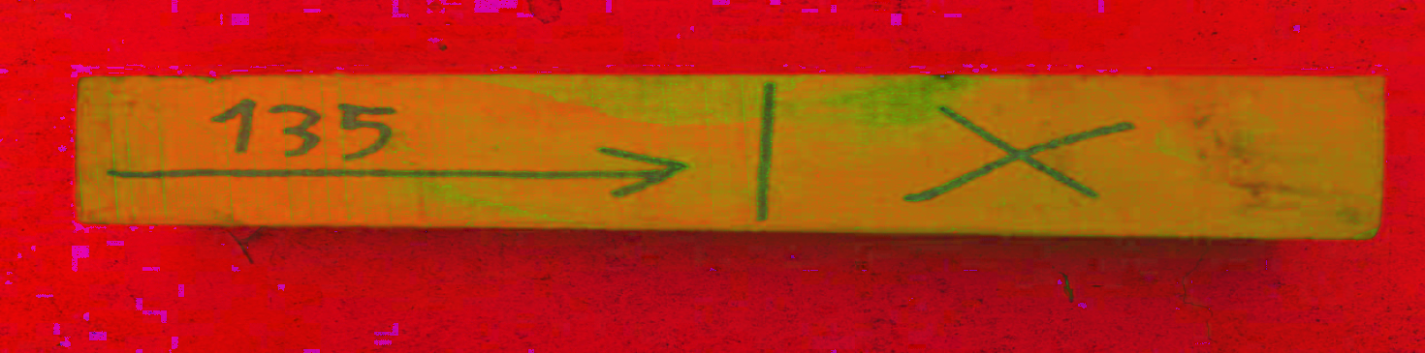
Preprocessing
The handwriting recognition system
Input image
Pre-processing
Symbol Classification
(CNN Model)
Digit Classification
(MNIST)
output image
Symbol preprocessing process
Input
image
hsv color image
Hue thresholding
Bitwise/
Masking
Opening
Morphological operation
Resizing
Standardization
Segmentation
output
image
Symbol Recognition
HSV color space
Dimensions of symbols
Detected digits and symbols seem satisfiable as seen.
Preprocessing steps
Detection of noise
Inputs symbols dimensions
Shapes, Test data set
Digits segmentation
Notes:
crop it from orginal
standardisation : to remove the noises
increase the accuracy

Slide 6
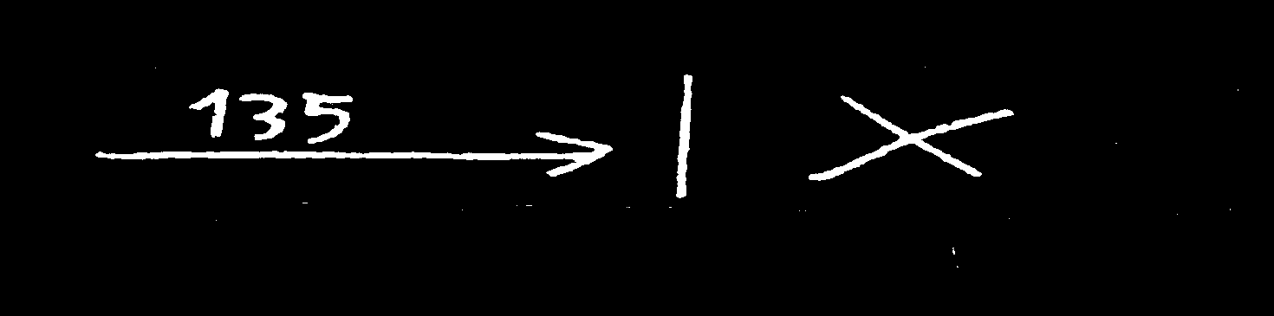
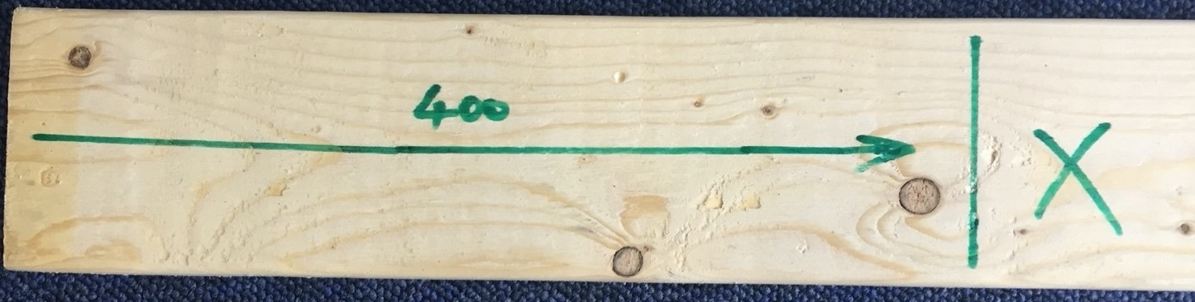
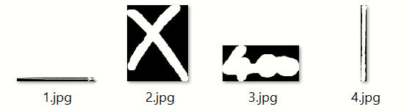
Preprocessing Results
The handwriting recognition system
Input image
Pre-processing
Symbol Classification
(CNN Model)
Digit Classification
(MNIST)
output image
Original image
Pre-processed image

Slide 7
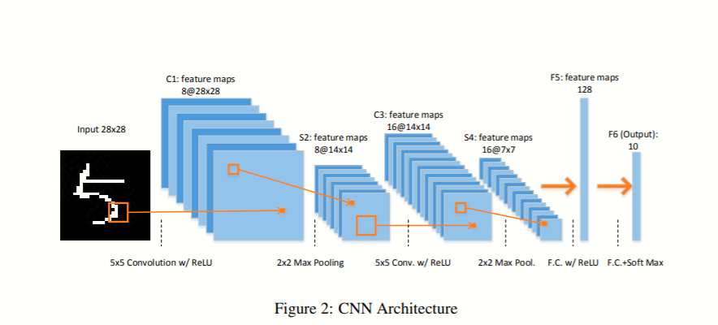
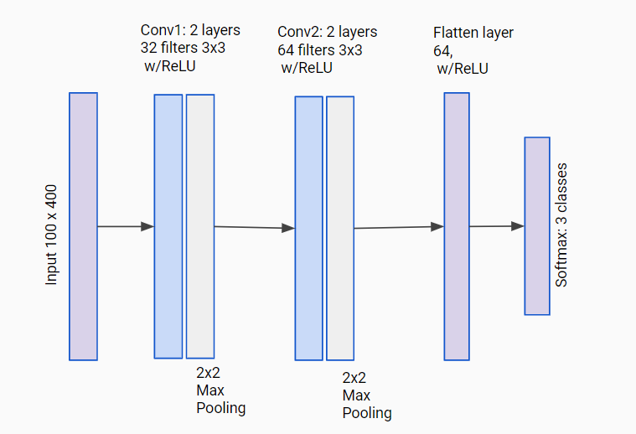
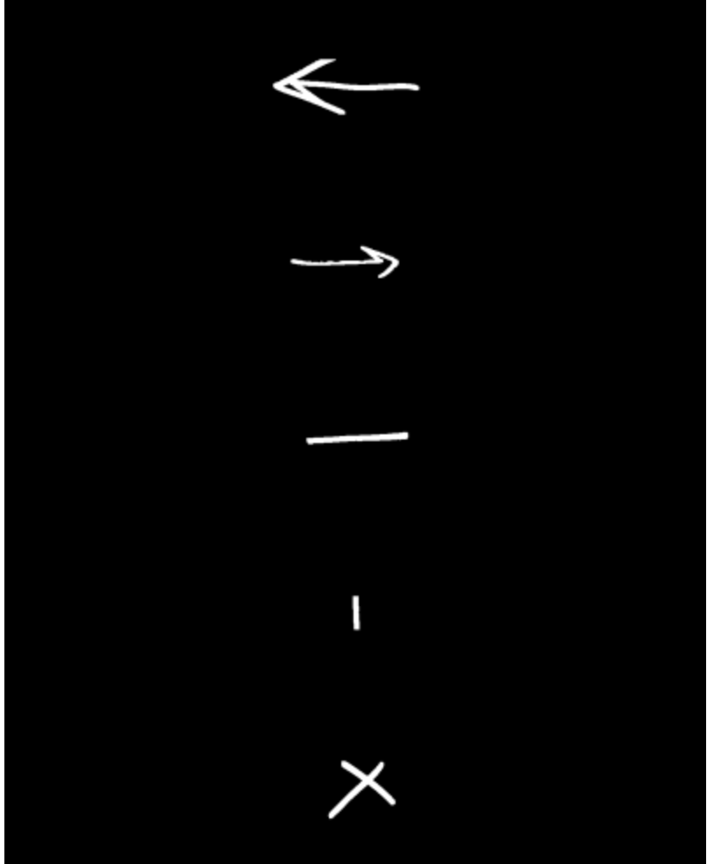
Symbol Classification
Layers
Pooling
Relu
Soft Max
cnn = models.Sequential([
layers.Conv2D(filters=32, kernel_size=(3, 3), activation='relu', input_shape=(100,400,1)),
layers.MaxPooling2D((2, 2)),
layers.Conv2D(filters=64, kernel_size=(3, 3), activation='relu'),
layers.MaxPooling2D((2, 2)),
layers.Flatten(),
layers.Dense(64, activation='relu'),
layers.Dense(4, activation='softmax')
])
Data sets
170 images for every symbol.
Rotation images for getting new ones.
Drop the bad images.
In final, totally 914 images are used for training and test.
Input image standardization
CNN model structure

Slide 8
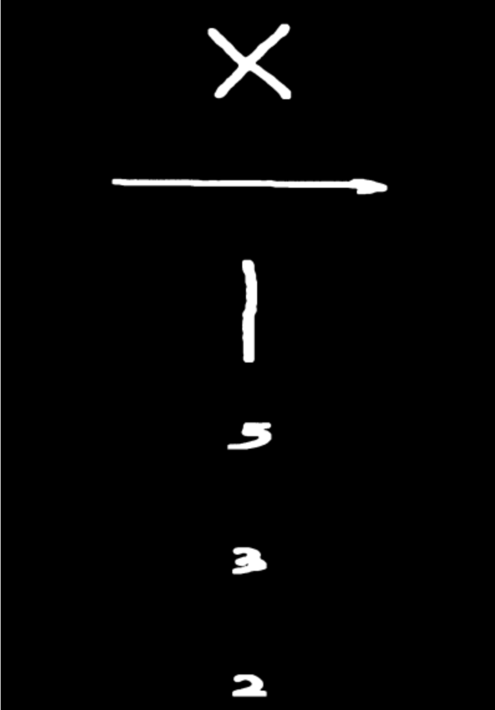
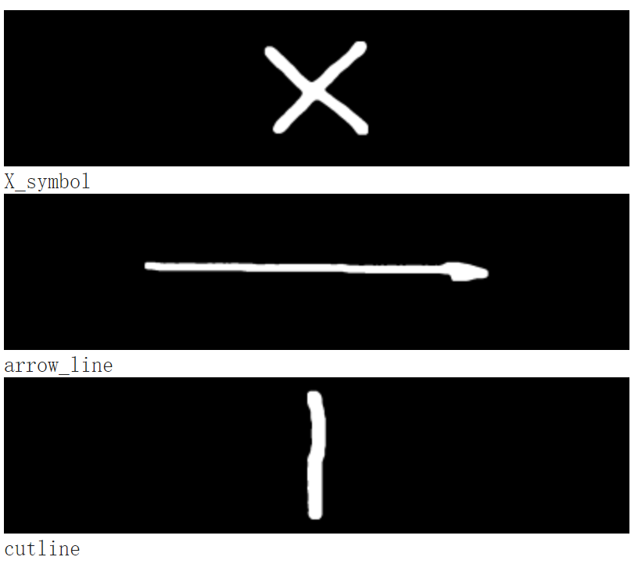

Symbols Classification Results
The handwriting recognition system
Input image
Pre-processing
Symbol Classification
(CNN Model)
Digit Recognition
(MNIST)
output image
Pre-processed image
Output image

Slide 9
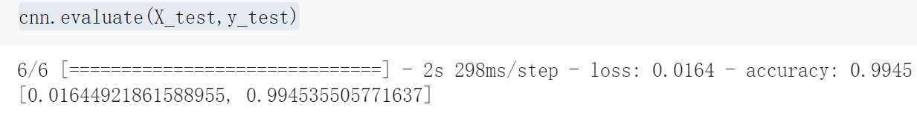
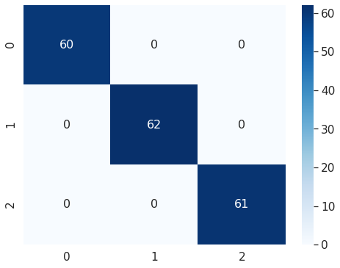
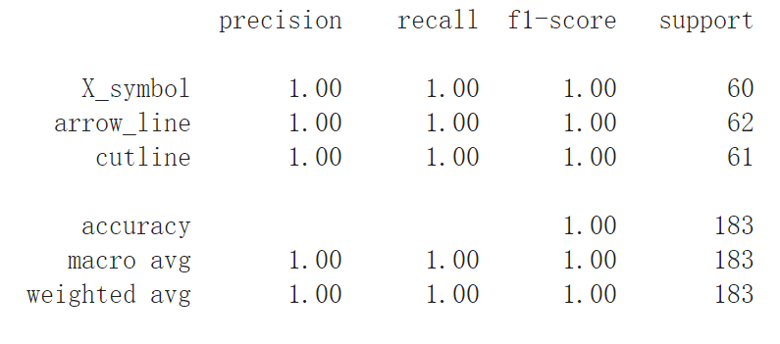
Symbols Classification
Layers
Pooling
Relu
Soft Max
Confusion Metrics
cnn = models.Sequential([
layers.Conv2D(filters=32, kernel_size=(3, 3), activation='relu', input_shape=(100,400,1)),
layers.MaxPooling2D((2, 2)),
layers.Conv2D(filters=64, kernel_size=(3, 3), activation='relu'),
layers.MaxPooling2D((2, 2)),
layers.Flatten(),
layers.Dense(64, activation='relu'),
layers.Dense(4, activation='softmax')
])

Slide 10
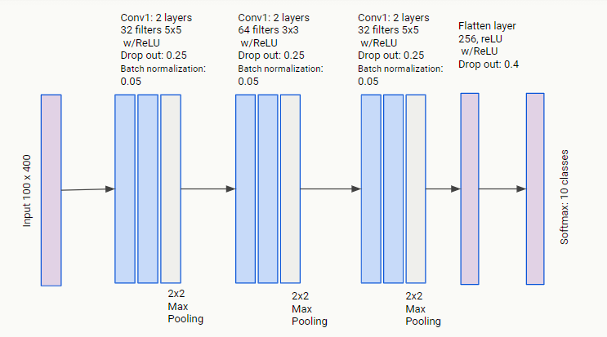
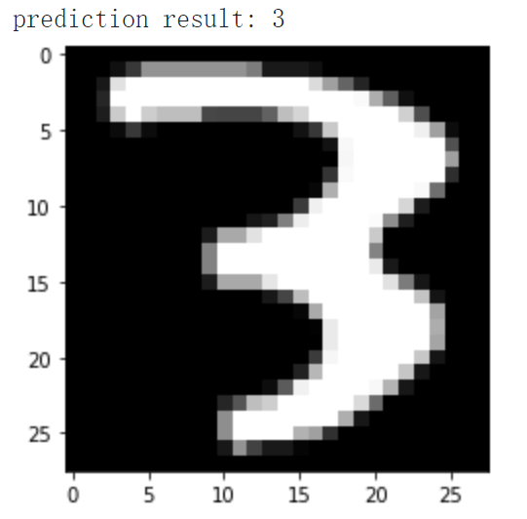
Digit Recognition
CNN Model Architecture
training data: 60000
test data: 30000
image size: 28*28

Slide 11
Digit Recognition
CNN Model Architecture
training data: 60000
test data: 30000
image size: 28*28
training data: 60000
test data: 30000
image size: 28*28

Slide 12
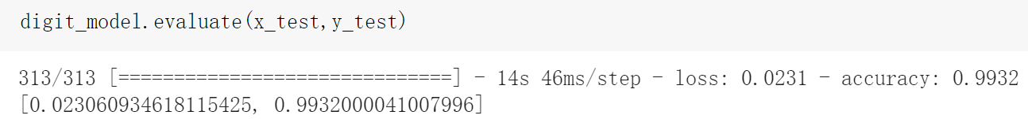
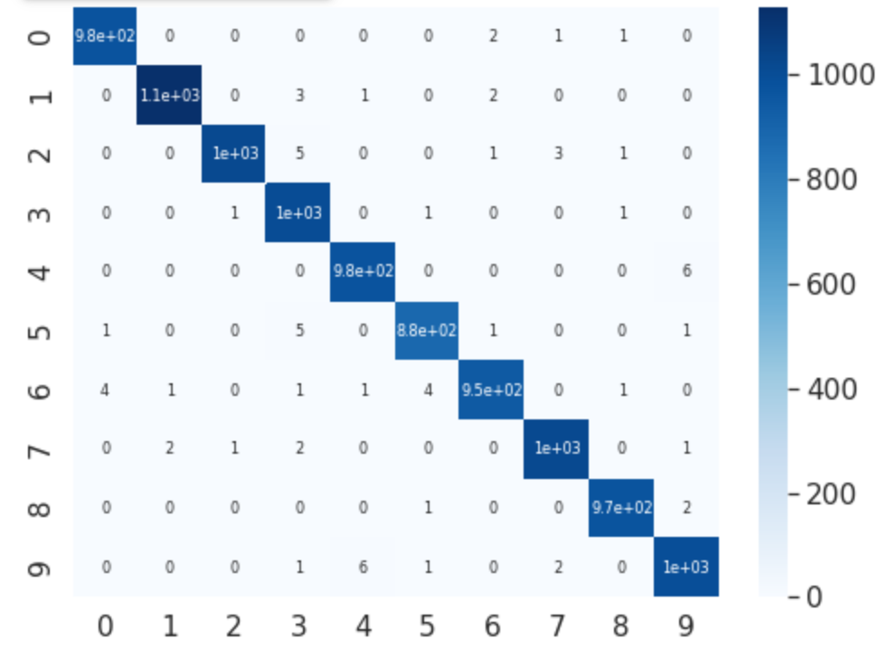
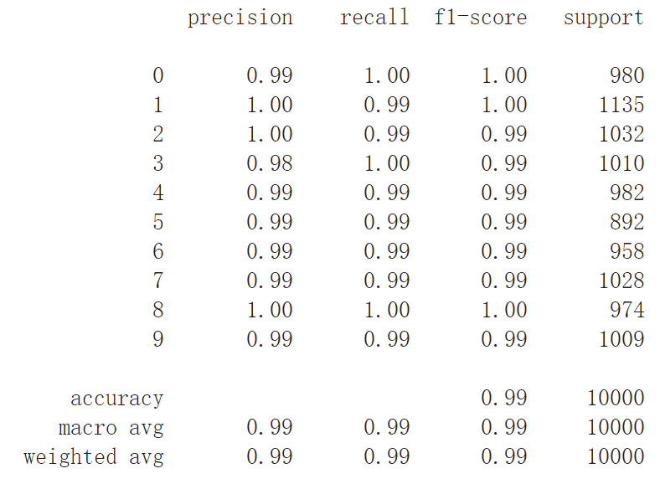
Digit Classification
cnn = models.Sequential([
layers.Conv2D(filters=32, kernel_size=(3, 3), activation='relu', input_shape=(100,400,1)),
layers.MaxPooling2D((2, 2)),
layers.Conv2D(filters=64, kernel_size=(3, 3), activation='relu'),
layers.MaxPooling2D((2, 2)),
layers.Flatten(),
layers.Dense(64, activation='relu'),
layers.Dense(4, activation='softmax')
])
Layers
Pooling
Relu
Soft Max
Confusion Metrics

Slide 13

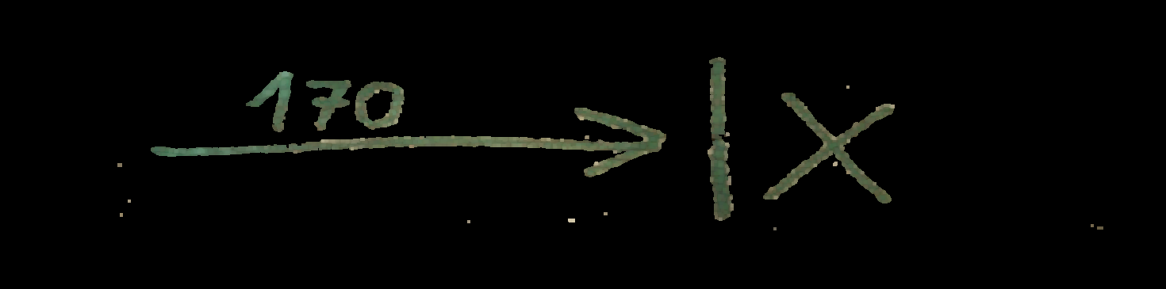
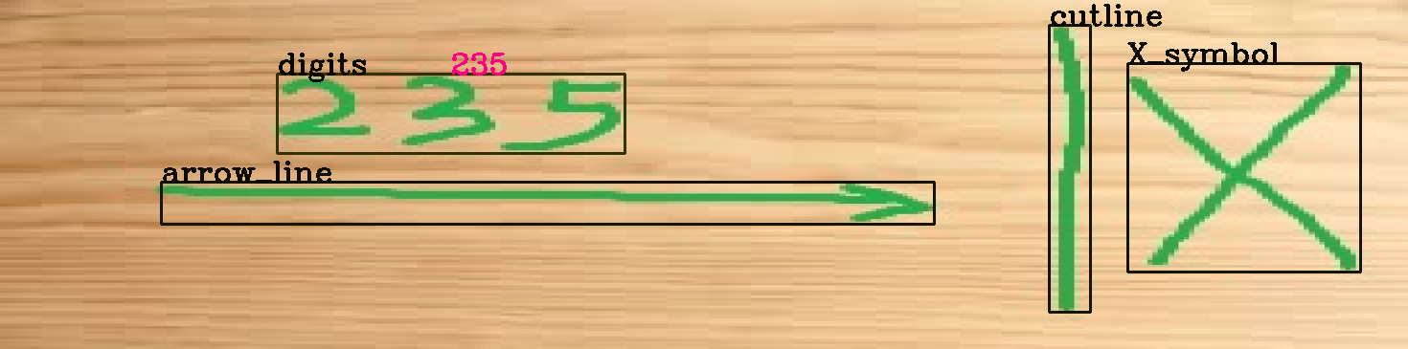
Test results
Model cannot generalize;
problem starts at the beginning, with pre-processing;
hue range, opening values tailored for single image;
even a little noise can make the difference.
test1.png
test2.png
test2.png

Slide 14
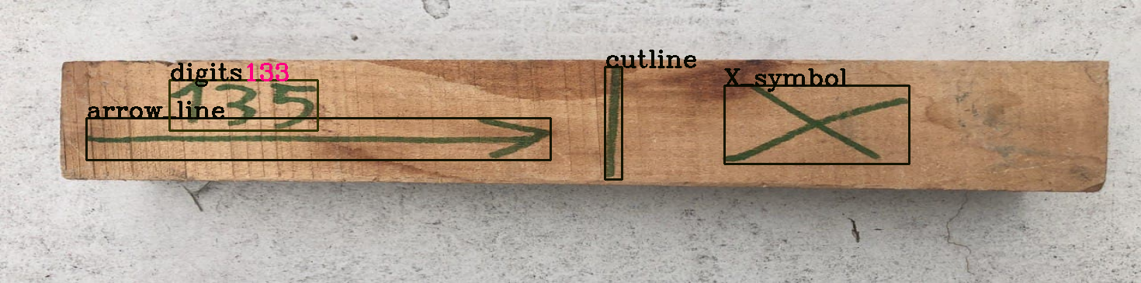

Reflections on results
We could have overcome this problem by building larger datasets that take into account noisy samples;
however this would have required much more time and effort.
A similar reasoning can be applied to the digit recognition model;
CNN is then probably not the best choice for this project.

Slide 15
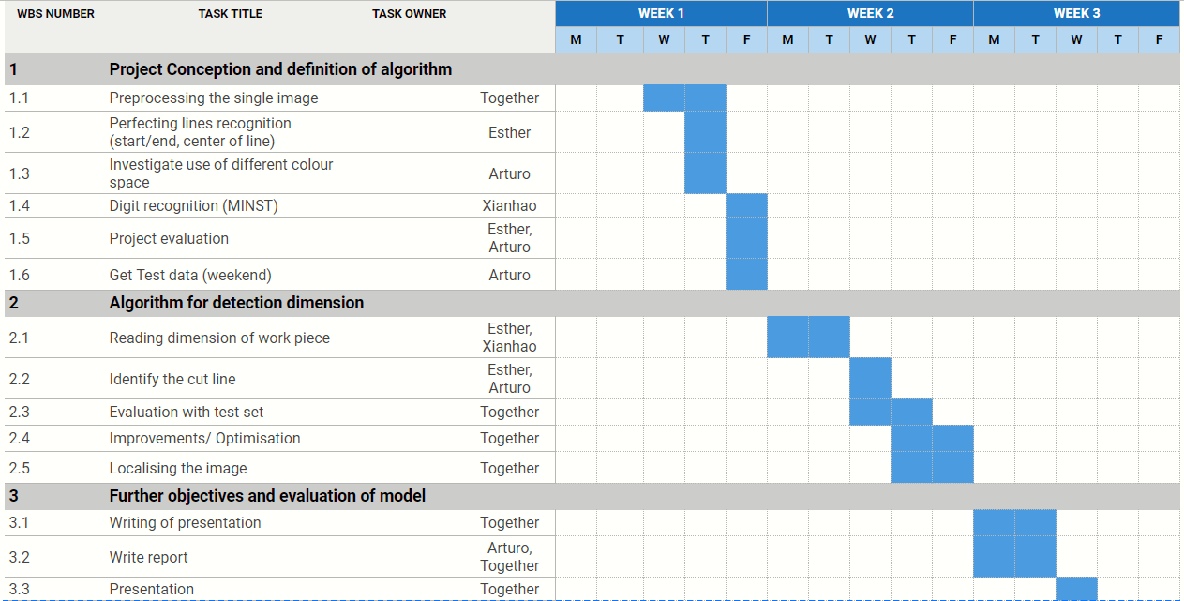
Project plan & management review
We followed the project plan with little deviation;
building the CNN models took more time than originally planned;
no time left for additional tasks;
limitations due to online work were not negligible;
difficulties in coordinating.

Slide 16

Thank you for listening!

